Slide 1
Driver Qualification Files
January 20, 2017
Chad Hoppenjan, CDS – Director of Transportation Safety Services

Slide 2
DQ file contents – 391.51
Every motor carrier must maintain a driver qualification file for each driver it employs. A complete listing of all driver qualification requirements is listed under Part 391 of the Federal Motor Carrier Safety Regulations.
What’s Required
Part 391 of the Federal Motor Carrier Safety Regulations details what a driver qualification file must contain.
https://www.fmcsa.dot.gov/regulations/title49/part/391

Slide 3
DQ file contents – 391.51
The following documents are to be included in a DQ file for each regularly employed driver (any employee with a CDL) (Part 391.51 of the Federal Motor Carrier Safety Regulations):
Driver's application for employment (always should be reviewed by attorney or Human Resources’ professional for compliance and correctness).
Motor vehicle record (MVR) from state(s), obtained at time of hire (Original MVR; kept for length of employment and for three years thereafter).
Road test form and certificate, or copy of CDL accepted in lieu of road test.
Medical exam certificate or (for CDL/CLP drivers) MVR showing current medical certification status (must be obtained within 15 days of driver obtaining or renewing medical certificate).
Verification that the medical examiner was listed on the National Registry of Certified Medical Examiners (for all exams after May 20, 2014).
Annual motor vehicle record (MVR) (keep for three years).
Annual review of driving record.
Certificate of Violations.
Pre-Employment Screening Program is not required to be placed in the DQ File.

Slide 4
DQ file contents – 391.51
The following documents are also required, but are not applicable to all drivers:
Documentation of any medical variance, exemption, or waiver.
Longer Combination Vehicle (LCV) Driver-Training Certificate.
Entry-level driver training certificate.
Section 391.53 details additional information related to a driver’s three-year safety performance history, to be kept in a secure location with controlled access (these should be kept separate of driver qualification files):
Driver’s written authorization to seek information about drug/alcohol testing history
Response(s) received from previous employer(s) or documentation of efforts to obtain the information.

Slide 5
Basic driver qualifications under 391.11
Other Basic driver qualification requirements for drivers include the following:
Must be at least 21 years old;
Can read and speak the English language well enough to do the job (including being able to read traffic signs, complete forms, and converse with enforcement officers);
Can safely operate the motor vehicle he/she will be driving;
Is physically qualified to operate the vehicle in accordance with Sec. 391.41;
Has a currently valid commercial motor vehicle operator’s license issued by only one state or jurisdiction;
Has provided a list of violations as required by Sec. 391.27;
Is not disqualified to operate a motor vehicle under Secs. 391.15 or 383.51; and
Has successfully completed a road test or its equivalent (Sec. 391.31, 391.33).

Slide 6
Required DQ file contents – 391.51
The motor carrier is required to maintain the entire driver qualification file for each driver (employee with CDL) it employs and for three years after employment ends.
The motor carrier can remove the following documents from a current driver’s qualification file after three years:
The motor vehicle record received from each State driver licensing agency to the annual driver record inquiry required by § 391.25(a);
The note relating to the annual review of the driver's driving record as required by § 391.25(c)(2);
The list or certificate relating to violations of motor vehicle laws and ordinances required by § 391.27;
The medical examiner's certificate required by § 391.43(g), a legible copy of the certificate, or for CDL drivers any CDLIS MVR obtained as required by § 391.51(b)(7)(ii);
Any medical variance issued by FMCSA, including a Skill Performance Evaluation Certificate issued in accordance with § 391.49; or the Medical Exemption letter issued by a Federal medical program in accordance with part 381 of this chapter; and
The note relating to verification of medical examiner listing on the National Registry of Certified Medical Examiners required by § 391.23(m).

Slide 7
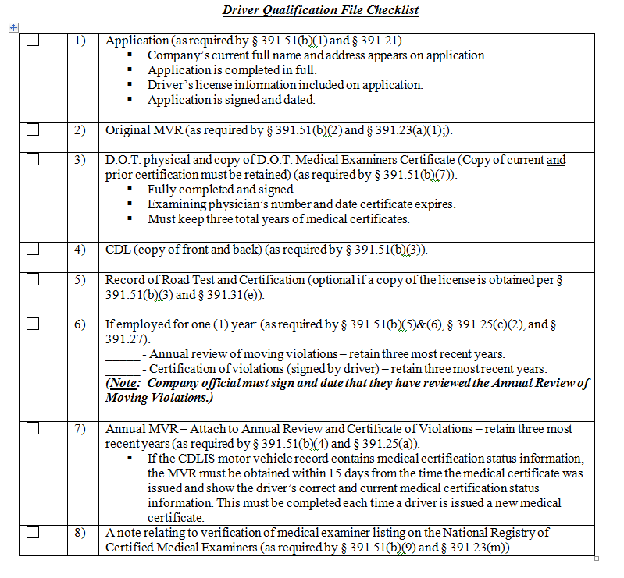
Sample DQ file checklist

Slide 8
Driver application – 391.21
Application must be fully completed and done accurately.
“Mistakes” can cause application to be “falsified”.
Common “mistakes”:
      Not reporting previous jobs
      Not reporting moving violations
      Not reporting crashes
      Not stating why employees left previous employer accurately
      Not reporting driving experience correctly

Slide 9
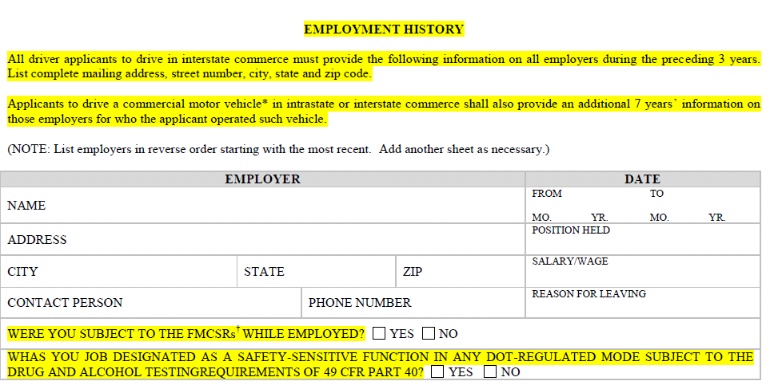
Driver application – 391.21

Slide 10
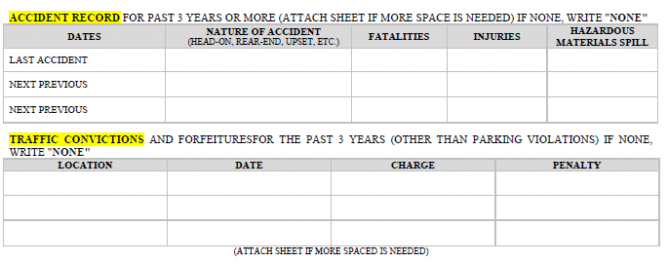
Driver application – 391.21

Slide 11
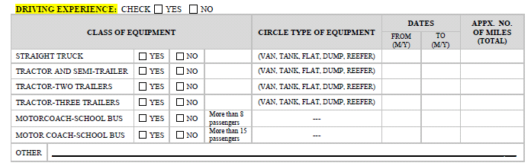
Driver application – 391.21

Slide 12
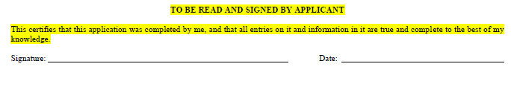
Driver application – 391.21

Slide 13
Frequently asked Questions – driver applications
Guidance for § 391.21: Application for employment.
Question 1: If a driver submits an application for employment and has someone else type, write, or print the answers to the questions for him and he signs the application, does this constitute a valid application?
Guidance: Yes. The applicant, by signing the application, certifies that all entries on it and information therein are true and complete to the best of the applicant’s knowledge.
Question 2: Is there a prescribed or specified form that must be used when a driver applies for employment, or can a carrier develop its own application?
Guidance: There is no specified form to be used in an application for employment. Carriers may develop their own forms, which may be tailored to their specific needs. The application form must, at the minimum, contain the information specified in §391.21(b).
Question 4: Must a driver’s application for employment include a social security number (SSN), as required by section 391.21(b)(2), if the applicant has religious objections to the SSN and the Social Security Administration does not require him or her to hold such a number?
Guidance: No.

Slide 14
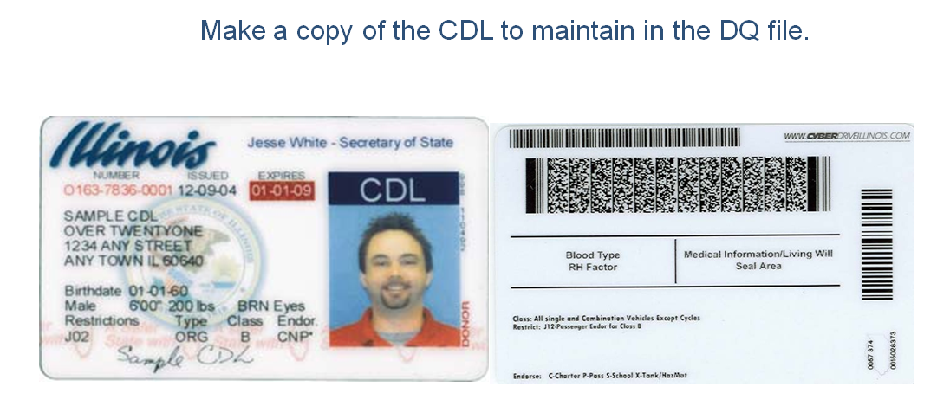
Commercial driver’s license (cdl)

Slide 15
Investigations and Inquiries (Within 30 Days of Hire)
§391.23(c)(2) The written record must contain (documentation):
  The name and address of each DOT-regulated employer
  The date the previous employer was contacted
  The date of attempted contact (if no reply/response)
  All safety performance information received
All failures of previous employers to respond to contact must be documented and should be reported to FMCSA under 386.12

Slide 16
Investigations and Inquiries (Within 30 Days of Hire)
391.23(d) At a minimum and for the past 3 years, you must obtain from each previous DOT-regulated employer:
  Driver identification/employment verification information
  Data regarding any DOT-recordable accident involving the driver
  Any violations regarding the prohibitions of part 382
  Information regarding a failure to complete a SAP as required
If driver does not have three years of driving experience, this must be noted in the file.
You must also provide the driver’s written consent to contact each previous employer

Slide 17
Annual MVR
MVRs must be obtained every 12 months.
Anything greater than 12 months is an error.

Slide 18
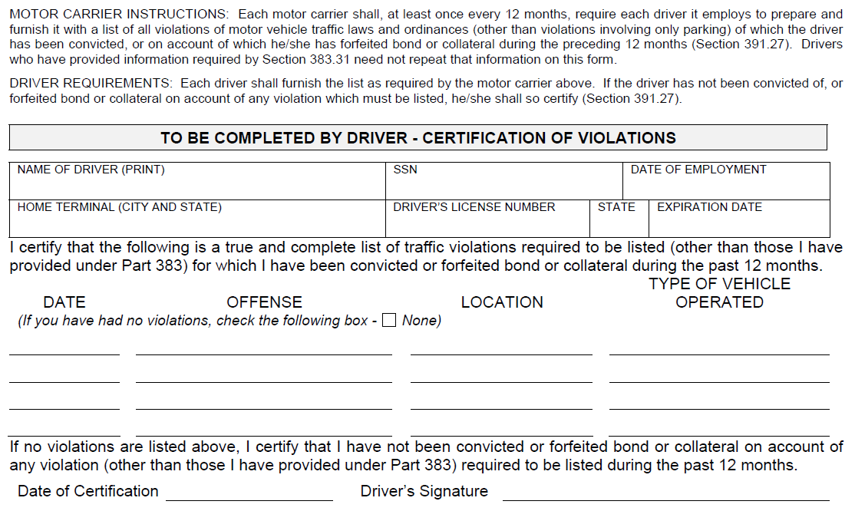
Certificate of Violations (Driver completes)

Slide 19
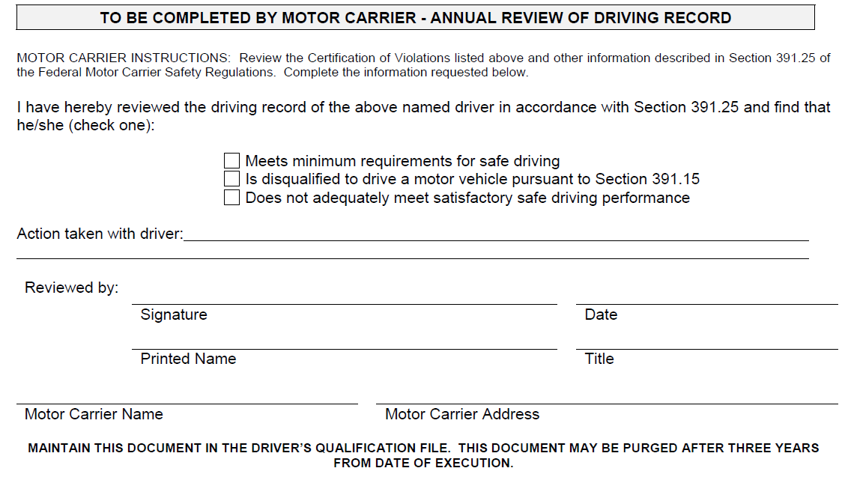
Annual review of Violations (company completes)

Slide 20
Medical examiner’s certificate – 391.41
Has no loss of a foot, a leg a hand, or an arm
Has no established medical history or clinical diagnosis of diabetes requiring insulin for control
Has no clinical diagnosis of any disqualifying heart disease
Has no clinical diagnosis of high blood pressure in accordance with new guidelines
Has no clinical diagnosis of epilepsy
Has 20/40 vision or better with corrected lenses
Has distant binocular acuity of at least 20/40 in both eyes
Has the ability to recognize the colors of traffic signals
Has hearing to perceive a forced whisper
Has no history of drug (Schedule 1) use or any other substance identified in Appendix D
Has no clinical diagnosis of alcoholism

Slide 21
Medical examiner’s certificate – 391.41
Recommend retaining long form in file, if possible. Will allow you to check for errors that medical examiner may have made.
Recommend maintaining medical certificate in file, if possible.
Must maintain 3 total years of medical certificates.

Slide 22
Medical examiner’s certificate – 391.41
https://www.fmcsa.dot.gov/medical/driver-medical-requirements/medical-applications-and-forms
Link to all appliacable forms.

Slide 23
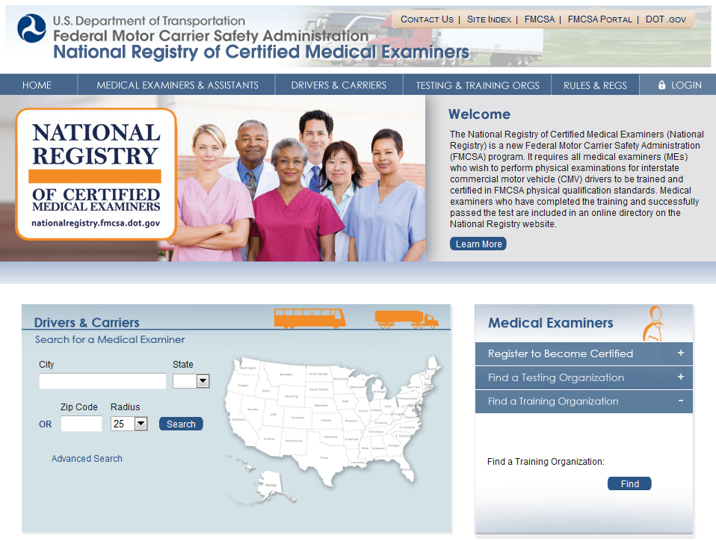
Are Your Doctor’s or the Drivers’ Doctors Certified with the National Registry?

Slide 24
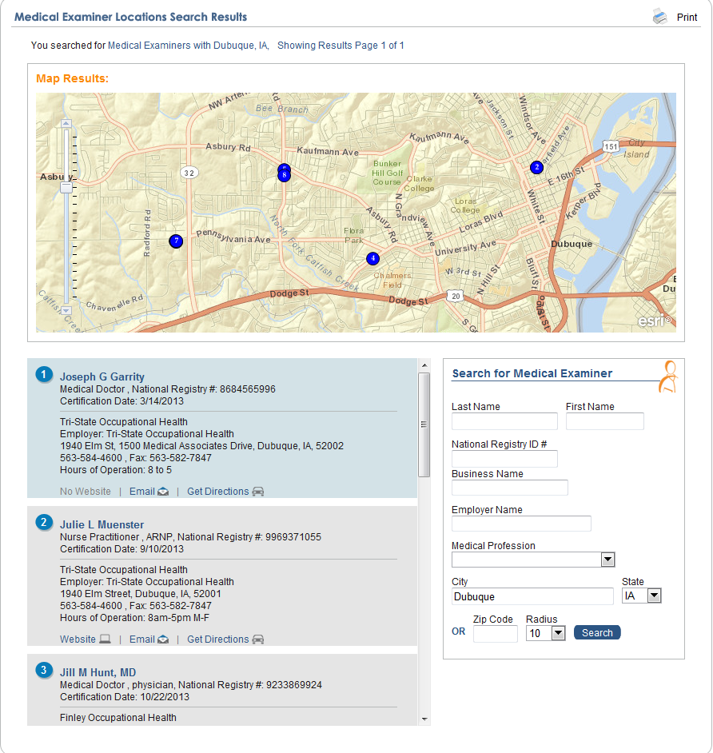
Are Your Doctor’s or the Drivers’ Doctors Certified with the National Registry?

Slide 25
DQ Files – Frequently asked questions
Question 2: How does §391.63 apply when motor carriers obtain, from a driver leasing service, intermittent, casual, or occasional drivers who are on temporary assignments to multiple motor carriers?
Guidance: If an intermittent, casual, or occasional driver has only been fully qualified by a driver leasing service or similar non-motor carrier entity, and has never been fully qualified by a motor carrier, the first motor carrier employing such a driver must ensure that the driver is fully qualified, and must keep a complete driver qualification file for that driver. It was the intention of §§391.63 and 391.65 to require that a driver, before entering the status of an "intermittent, casual, or occasional" driver, be fully qualified by a motor carrier. In a contractual relationship between a motor carrier and a driver leasing service, this may be accomplished by a motor carrier designating a driver leasing service as its agent to perform the qualification procedures in accordance with parts 383 and 391. However, in such a case, the motor carrier will be held liable for any violations of the FMCSRs committed by its agent.

Slide 26
QUESTIONS?

